Slide 1
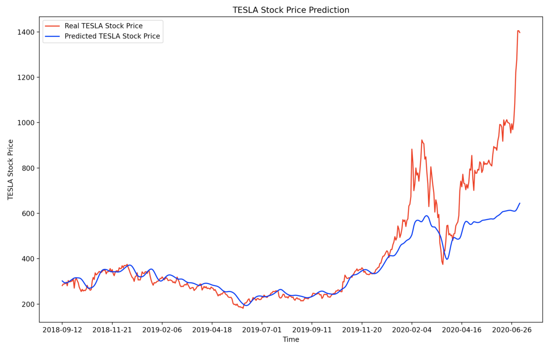
STOCK PRICE PREDICTION
Using Machine Leaning (LTSM)

Slide 2
CONTENT
Abstract
What is Stock Market?
How to read a Stock Table ?
Dataset
Different Types of Models Available : Linear Regression and LSTM
Apple Inc. Stock Price Dataset
Model Fitting
Conclusion
References

Slide 3
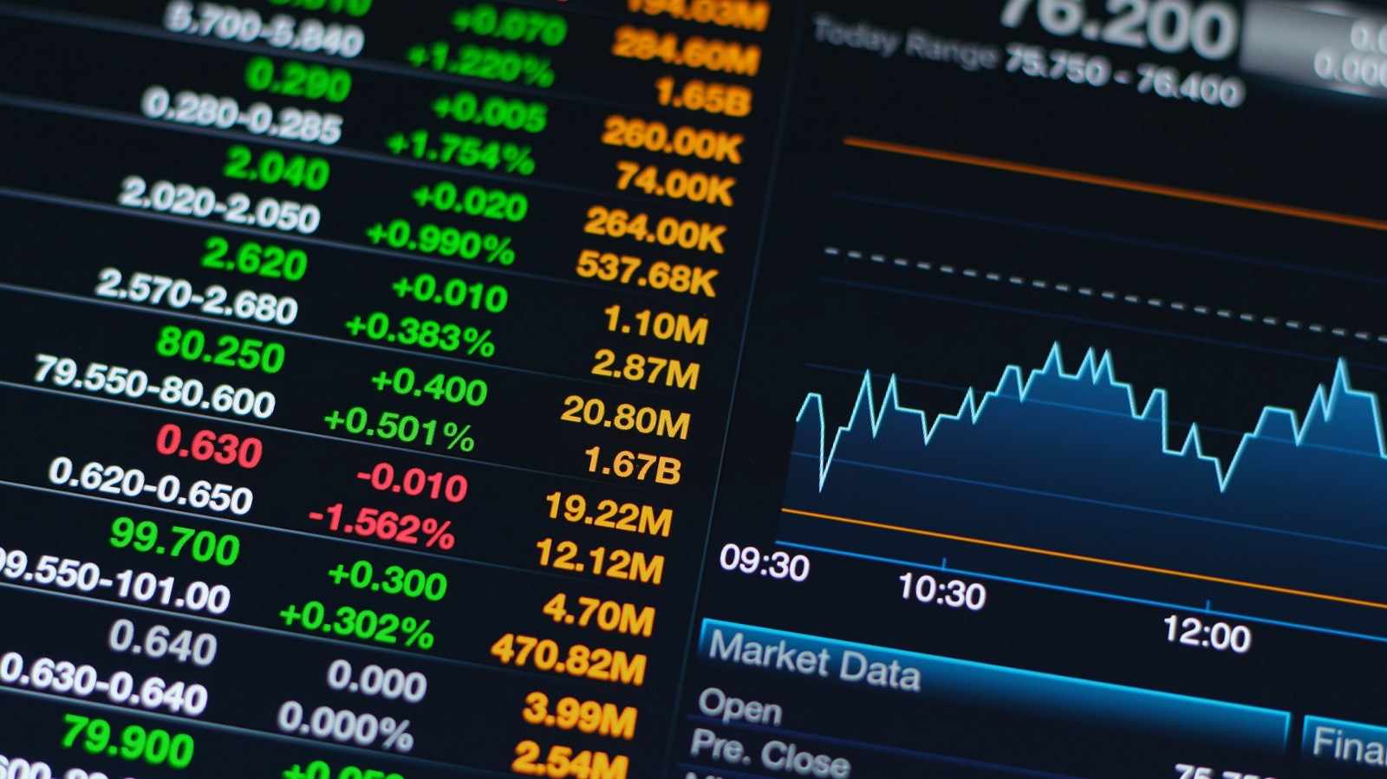
ABSTRACT
Demand of Stock have become huge with Increased in popularity of Stock in Digital world. Prediction and Analysing stock can benefit People to think before buying or selling stocks. So, A New Stock Price Prediction through Deep Learning Algorithms has been analyzed and visualized. Through This System we can predict of any Company stock in the world.

Slide 4

WHAT IS STOCK MARKET ?
A stock market is a public market for the trading of company stock. Stock market allows us to buy and sell units of stocks (ownership) of a company.
If the company's profits go up, then we own some of the profits and if they go down, then we lose profits with them.
If more sellers than buyers, stock prices tend to fall. Conversely, when more buyers than sellers, stock prices tend to rise

Slide 5
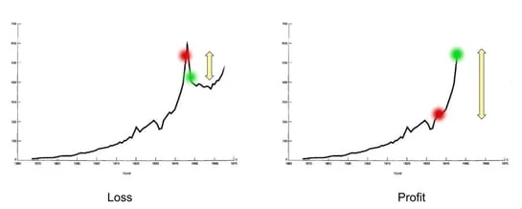
WHAT IS STOCK MARKET ?
Red is purchased Stock.
Green is sold Stock.

Slide 6
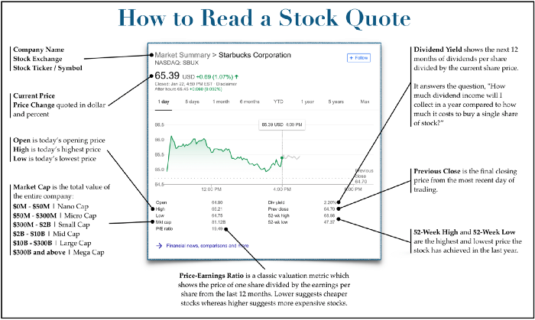
HOW TO READ A STOCK TABLE ?

Slide 7
HOW TO READ A STOCK TABLE ?
Company Name
This provides the full name of the publicly-traded entity.
Stock Exchange
This shows which exchange the stock is trading on (such as the Nasdaq or New York Stock Exchange). This usually doesn’t matter much, unless it’s trading on over-the-counter (OTC) markets, which are often highly speculative.
Stock Ticker/Symbol
This is the shorthand symbol used to identify the stock when looking it up for research or purchase. For stocks the symbol is usually 1–4 letters long, although it can be longer.
Current Price
This is the most recent price available. If markets are currently open, this price will be either real-time or delayed by 15 minutes. If markets are closed, this is typically the closing price from the most recent day of trading.

Slide 8
HOW TO READ A STOCK TABLE ?
Price Change
This shows how much the price has changed today (if markets are open) or during the most recent day of trading (if markets are closed). This is quoted in dollars and also percent. We believe percent change is a more useful figure, since a dollar change is meaningless without comparing it to the previous closing price of the stock.
Open/High/Low
These show the stock’s trading range for the day by providing where it opened, the maximum price it reached, and the minimum price it reached.
These data points are most useful on highly volatile days or to day traders interested in tracking small, intraday price movements. To the average investor looking to buy a stock for weeks, months, or years, the day’s price range is only moderately useful.
Market Cap (or market capitalization)
This is the total value of all the shares of a publicly traded company. Mathematically, it’s the number of shares multiplied by the price per share.
When investors talk about “market caps” they’re simply discussing how big a company is.

Slide 9
HOW TO READ A STOCK TABLE ?
Price-Earnings Ratio
This is one of the most popular value metrics that investors use to try and determine if a stock is cheap or expensive. It represents the price of one share divided by the earnings per share for the last 12 months.
Dividend Yield
This is a measure of how much return the dividend will provide, relative to the current stock price. It divides the next 12 months of dividend income by the current share price.
Previous Close
This is the final closing price from the most recent day of trading. From Tuesday to Friday, this is usually the previous calendar day. On Monday, it’s usually last Friday’s closing price.
52-Week High and 52-Week Low
These are the highest and lowest prices the stock has traded at in the trailing year (52 weeks). This can be useful to get a sense of how close the stock currently is to setting new lows or breaking new highs for the year.

Slide 10
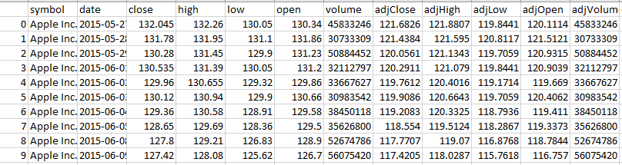
DATASET
The data used in this project is of the Apple Inc. from May 27, 2015 to May 22, 2020.
This is a data points indexed in time order or a time series. Our Goal was to predict
the closing price for any given date after training.

Slide 11
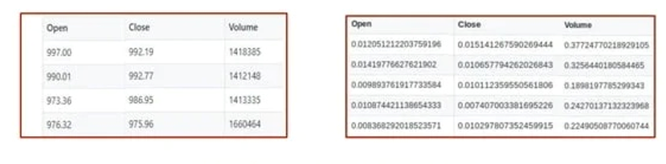
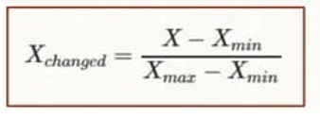
Denormalized Dataset Normalized Dataset

Slide 12
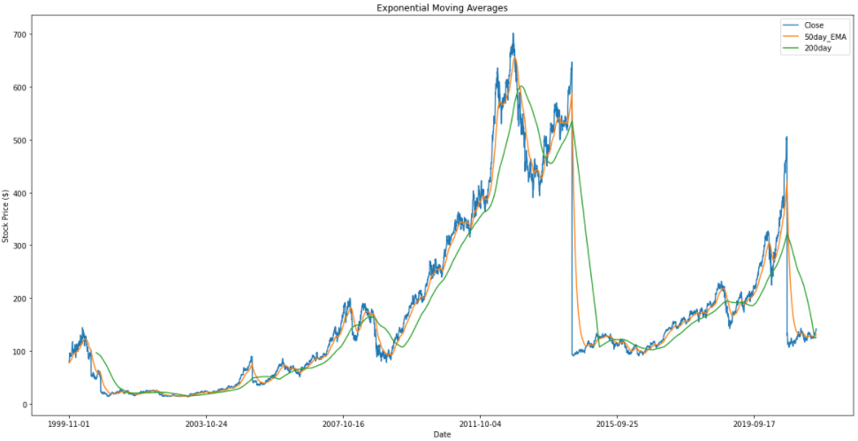
So, What are the Different Models Available ?
Linear Regression
Recurrent Neural Network + LSTM

Slide 13
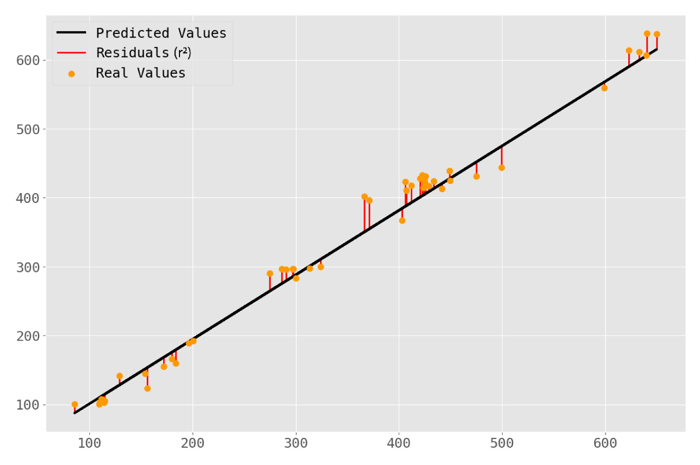
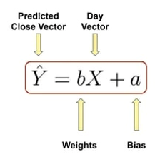
LINEAR REGRESSION
Linear Regression is an approach for predictive modelling to showcase the relationship between a scaler dependent variable (in this case, it is ‘stock’) and one or more independent variables (in this case, it is ‘Time’).
Prediction can be done along the straight line. The equation of the line is gives as follows:

Slide 14
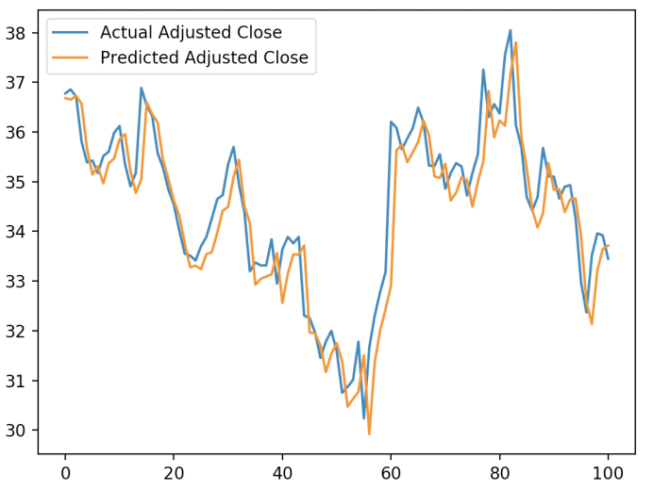
RECURRENT NEURAL NETWORK + LSTM (LONG SHORT TERM MEMORY)
Long Short Term Memory is a kind of recurrent neural network. In RNN output from the last step is fed as input in the current step.
It tackled the problem of long-term dependencies of RNN in which the RNN cannot predict the word stored in the long-term memory but can give more accurate predictions from the recent information.
As the gap length increases RNN does not give an efficient performance. LSTM can by default retain the information for a long period of time.
It is used for processing, predicting, and classifying on the basis of time-series data.

Slide 15

APPLE INC. STOCK PRICE DATASET
Apple Inc. is an American multinational technology company that specializes in products. Apple is the largest technology company by revenue (totaling US$365.8 billion in 2021) and, as of June 2022, is the world's biggest company by market capitalization, the fourth-largest personal computer vendor by unit sales and second-largest mobile phone manufacturer.
It is considered one of the big four Internet stocks along with Amazon, Meta and Google
The company is listed on the NASDAQ stock exchange under the ticker symbol AAPL.
We have Included 5 year Stock Price of Apple for this Project and the data is collected through NASDAQ API’s.

Slide 16
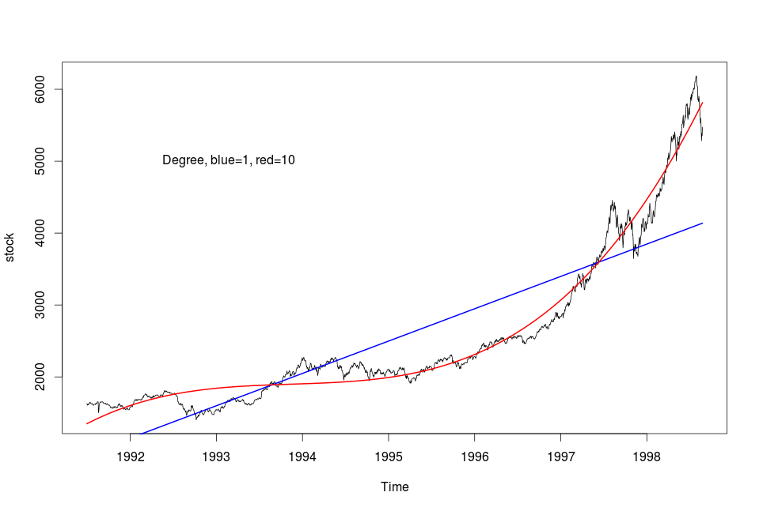
MODEL FITTING
Stock Price Prediction is a complex problem and is difficult to predict. Machine Learning Models doesn't perform well as compared to Deep Learning
Models. Following is the result:
The Straight Line represents the fit by linear regression
which does not fit properly whereas the curve done
which was done through long short term memory
(LSTM) fits very better.

Slide 17
CONCLUSION
We can see the Prediction, analysis and Visualization of Apple Inc. Stock Price through applying Deep learning algorithms such as LSTM.
Same way we can use any company Stock Dataset directly apply this algorithms it will give us the correct prediction.
This System is Successfully runs on any system even on Cloud platforms such as Google Collaboratory.

Slide 18
REFRENCES
https://machinelearningmastery.com/start-here/#getstarted
https://colah.github.io/posts/2015-08-Understanding-LSTMs/
https://www.sas.com/en_us/insights/analytics/machine-learning.html
https://groww.in/us-stocks/aapl
https://www.investopedia.com/terms/d/deep-learning.asp
https://www.nasdaq.com/market-activity/stocks/aapl

